Slide 1
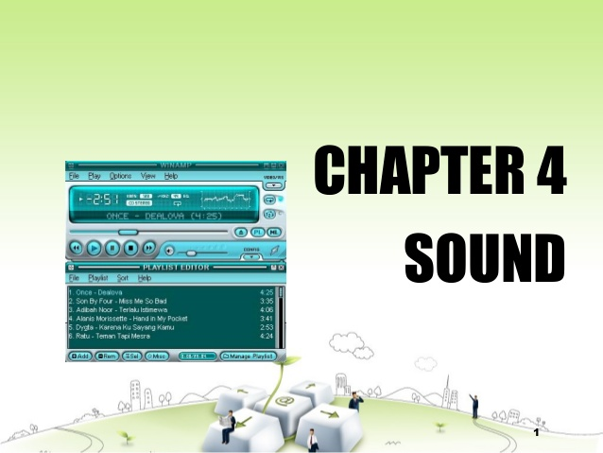

Slide 2
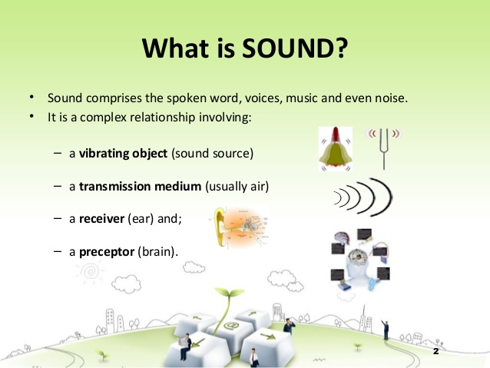

Slide 3

Basic of Digital Audio
Basic of Sound
Sound: a travelling wave that is an oscillation of pressure transmitted through a solid, liquid, or air, composed of frequencies within the range of hearing.
A
Period
Amplitude
t
Essential Properties
Amplitude: the magnitude of change during one oscillation.
Period: the time interval between two successive occurrences of a recurrent event.
Frequency: the number of occurrences of a repeating event per unit time.
Notes:
Audio info is cruicial for multimedia presentation and in a sense, is the simplest type of multi data.
When you see a visual waveform that represents audio, it reflects these waves of air pressure. The zero line in the waveform is the pressure of air at rest. When the line swings up to a peak, it represents higher pressure; when the line swings down to a trough, it represents lower pressure.
Amplitude
Reflects the change in pressure from the peak of the waveform to the trough. High-amplitude waveforms are loud; low-amplitude waveforms are quiet.
Cycle
Describes a single, repeated sequence of pressure changes, from zero pressure, to high pressure, to low pressure, and back to zero.
Frequency
Measured in hertz (Hz), describes the number of cycles per second. (For example, a 1000-Hz waveform has 1000 cycles per second.) The higher the frequency, the higher the musical pitch.

Slide 4
How sound waves interact
When two or more sound waves meet, they add to and subtract from each other.
Notes:
If their peaks and troughs are perfectly in phase, they reinforce each other, resulting in a waveform that has higher amplitude than either individual waveform.
If the peaks and troughs of two waveforms are perfectly out of phase, they cancel each other out, resulting in no waveform at all.
In most cases, however, waves are out of phase in varying amounts, resulting in a combined waveform that is more complex than individual waveforms.

Slide 5
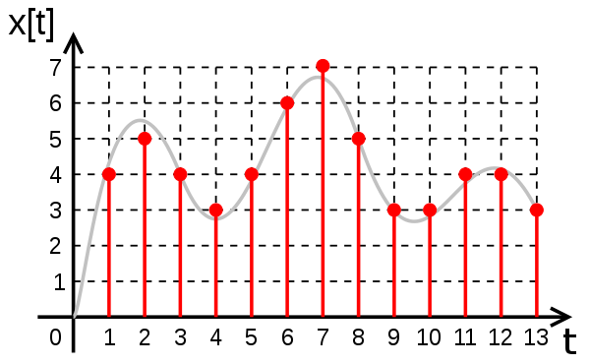
2.2 Audio Digitalization
Audio signals
Analog Signal: an electrical representation of sound originated by microphone, tape head. Loudspeakers or headphones convert an electrical audio signal into sound.
Digital Signal: a discrete-time signal for which not only the time but also the amplitude has discrete values
Notes:
An audio signal is a representation of sound, typically as an electrical voltage. Audio signals have frequencies in the audio frequency range of roughly 20 to 20,000 Hz (the limits of human hearing). Audio signals may be synthesized directly, or may originate at a transducer such as a microphone, musical instrument pickup, phonograph cartridge, or tape head. Loudspeakers or headphones convert an electrical audio signal into sound. Digital representations of audio signals exist in a variety of formats
Acoustical:听觉的，声学的A microphone converts the pressure waves of sound into voltage changes in a wire: high pressure becomes positive voltage, and low pressure becomes negative voltage.
When you record from a microphone into a computer, for example, analog-to-digital converters transform the analog signal into digital samples that computers can store and process.
Since we are interesting in working with such data in computer storage,we must digitize the analog signal produced by microphone. digitize means conversion to a stream of number.

Slide 6
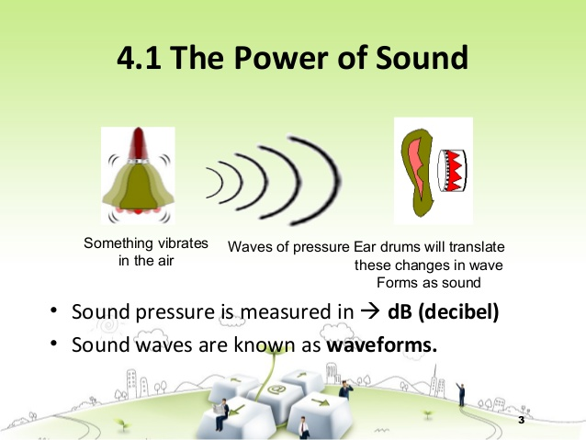

Slide 7
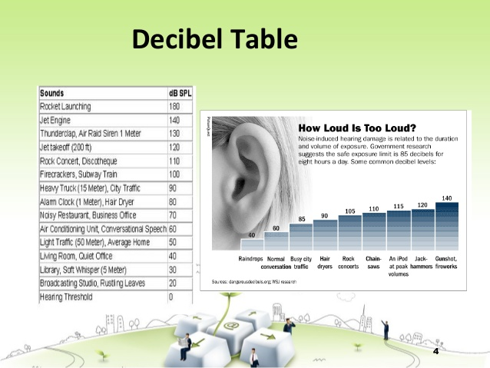

Slide 8
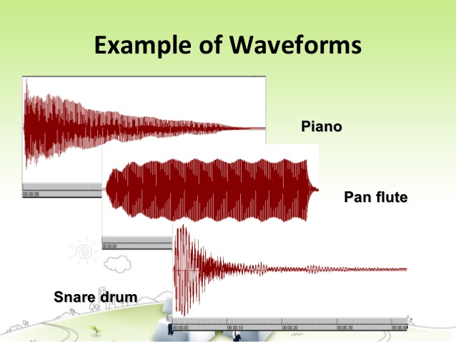

Slide 9
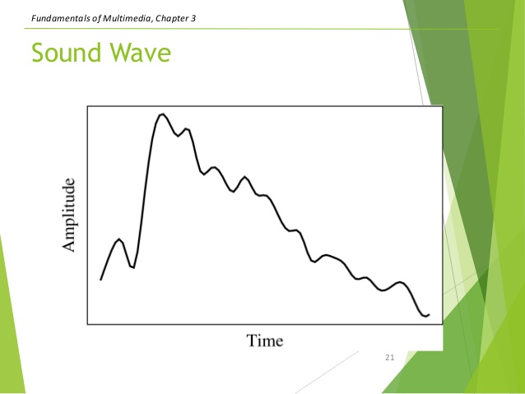

Slide 10
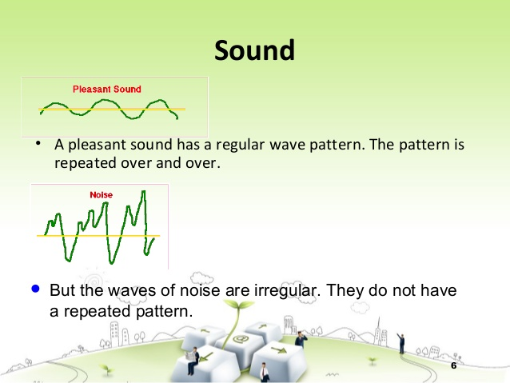

Slide 11
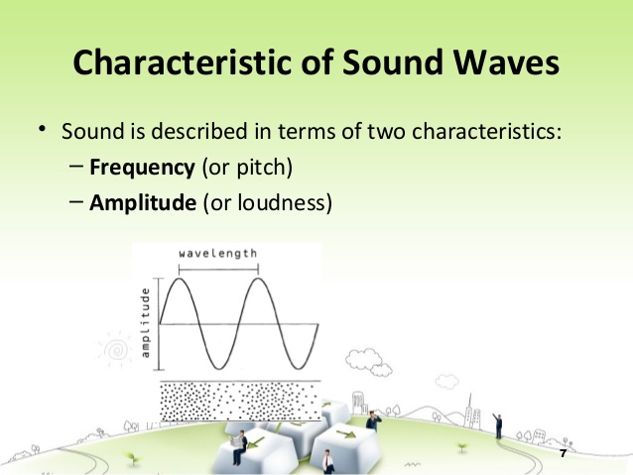

Slide 12
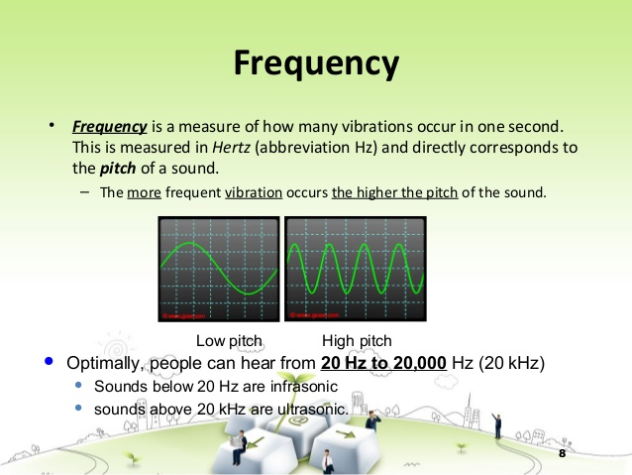

Slide 13
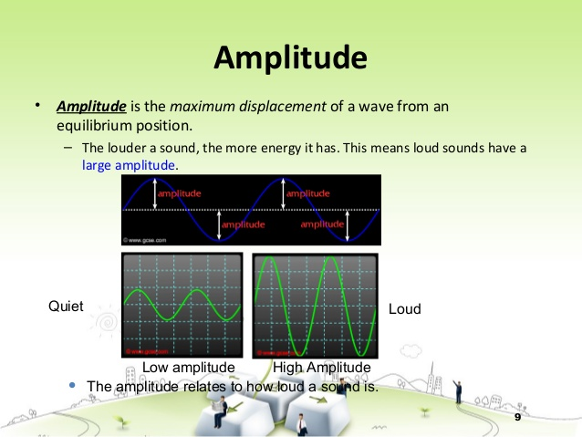

Slide 14
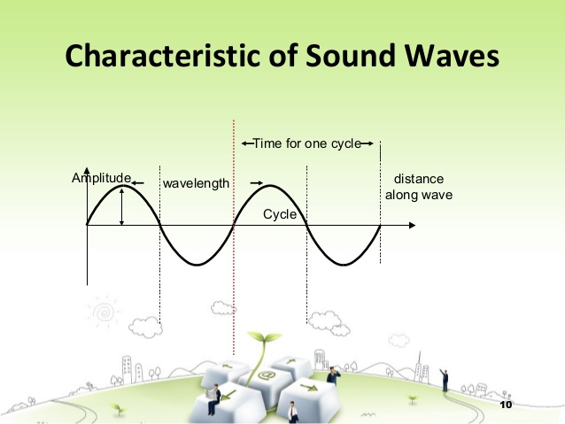

Slide 15
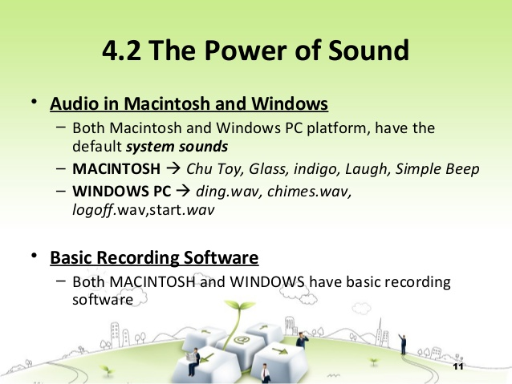

Slide 16
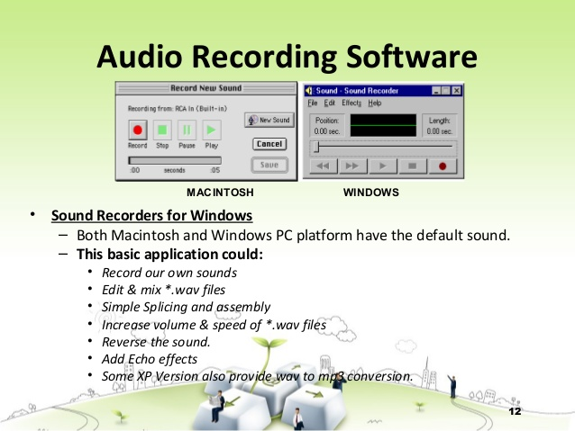

Slide 17
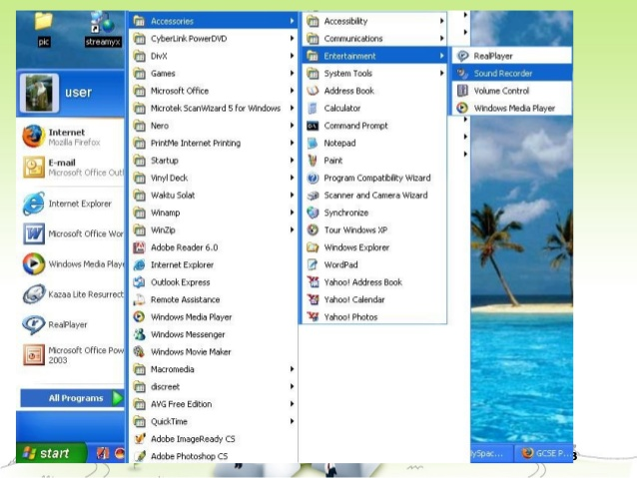

Slide 18
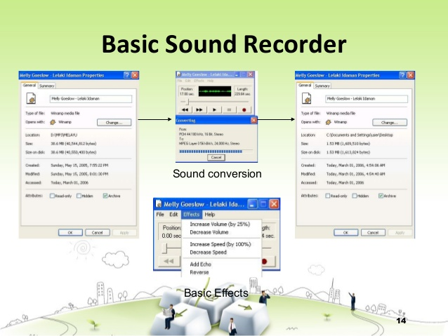

Slide 19
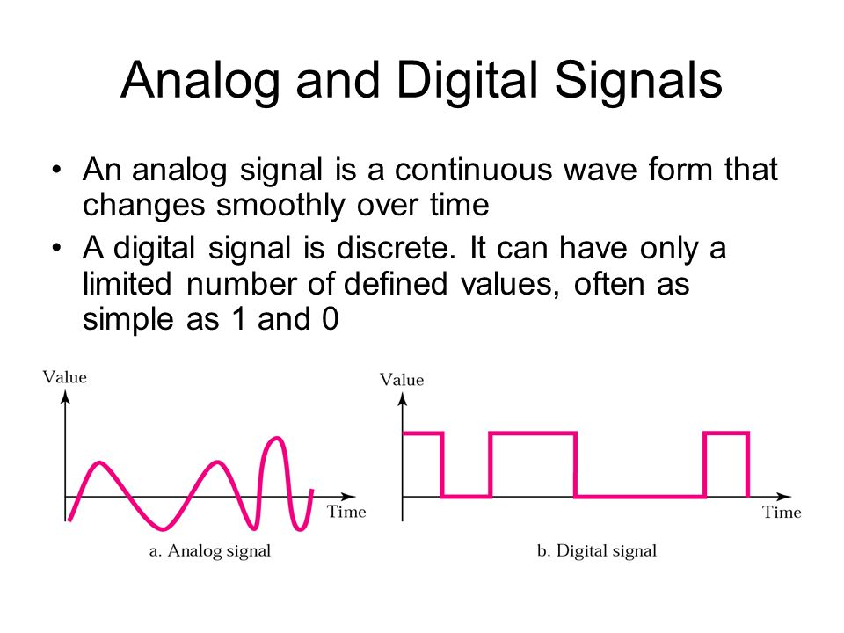

Slide 20
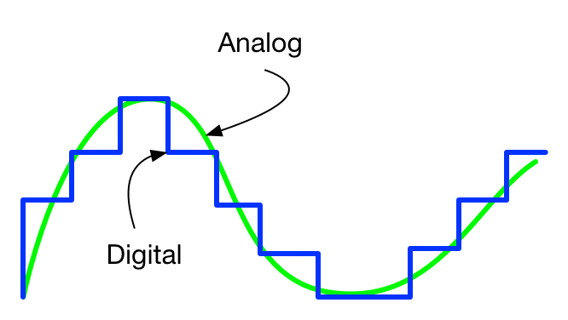

Slide 21
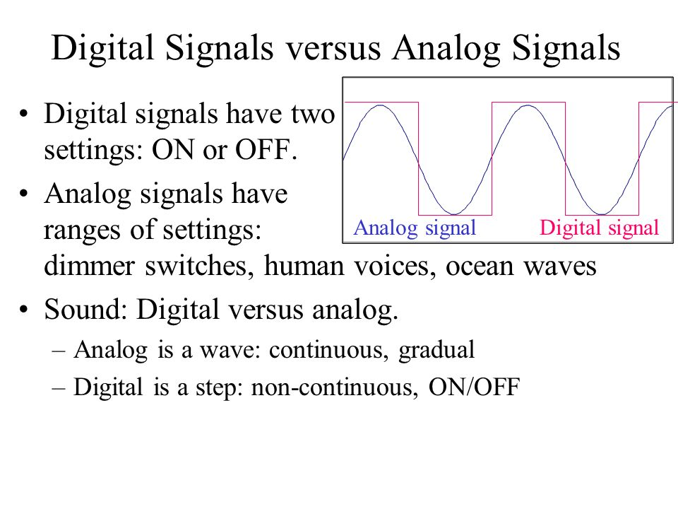

Slide 22
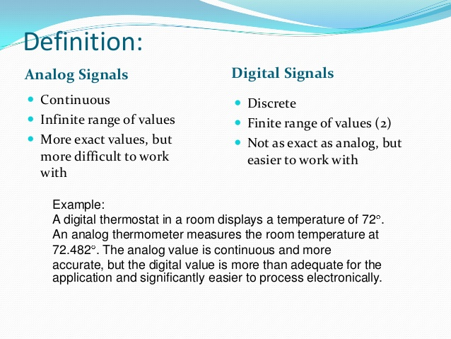

Slide 23
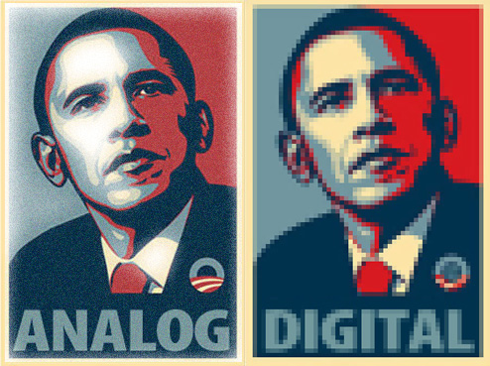

Slide 24
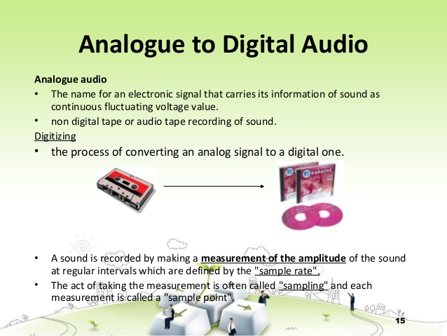

Slide 25
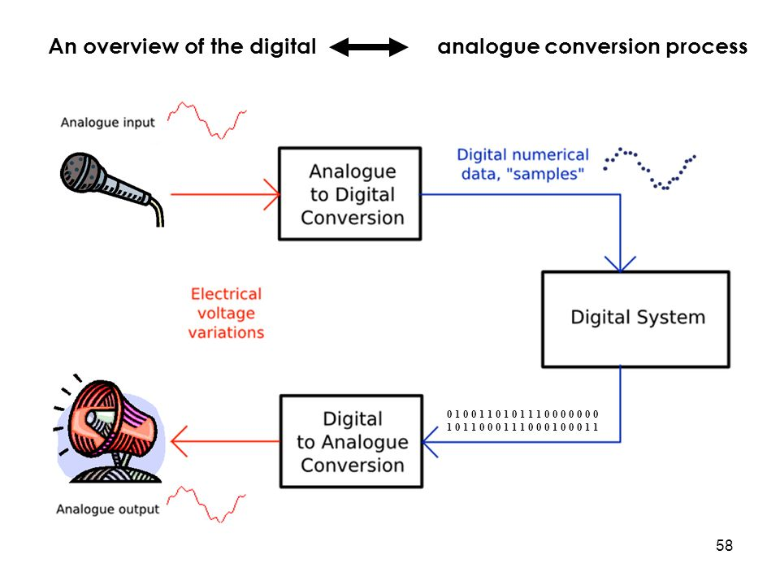

Slide 26
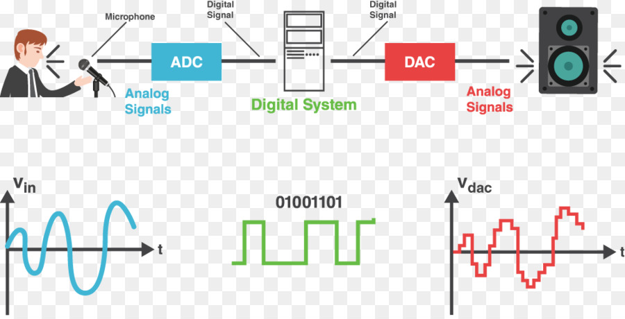

Slide 27
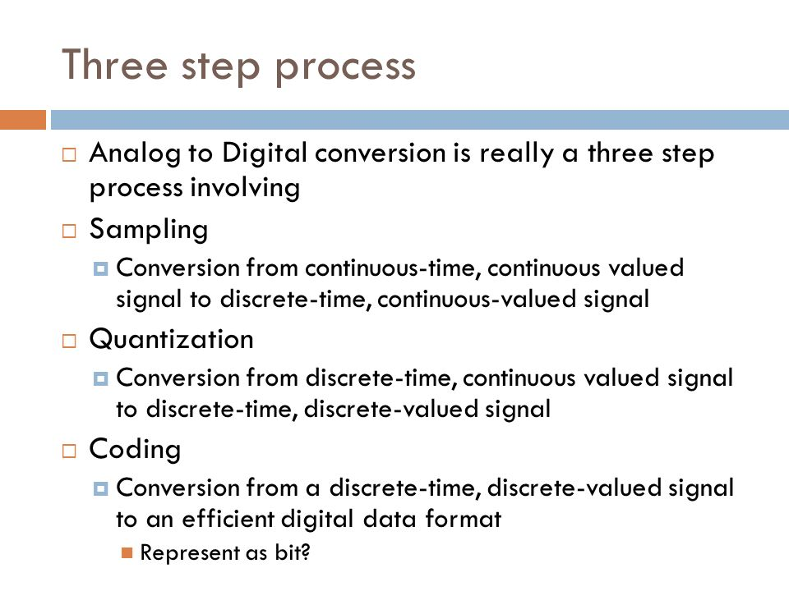

Slide 28
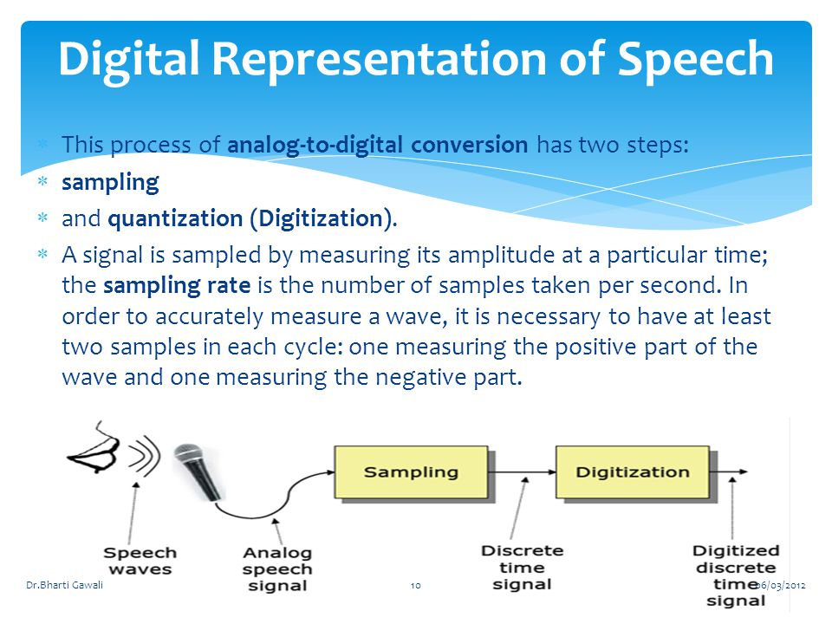

Slide 29
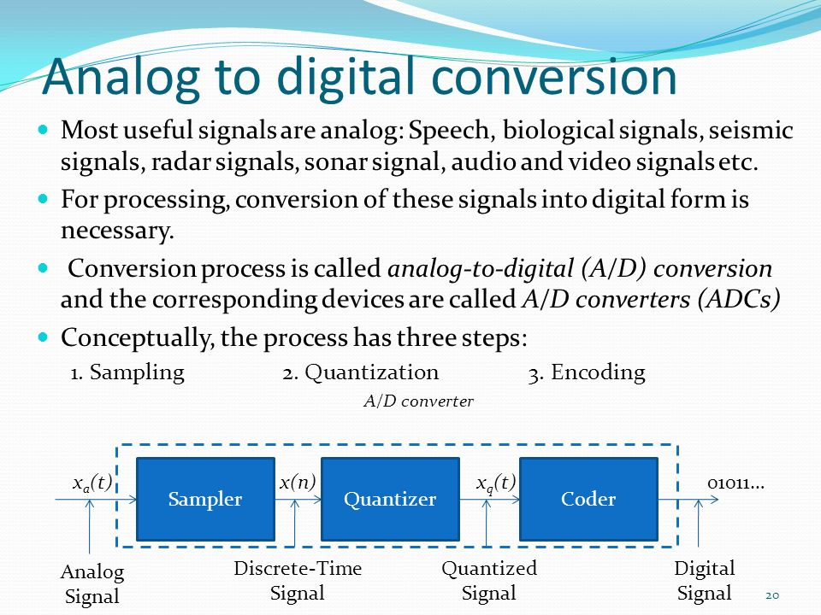

Slide 30
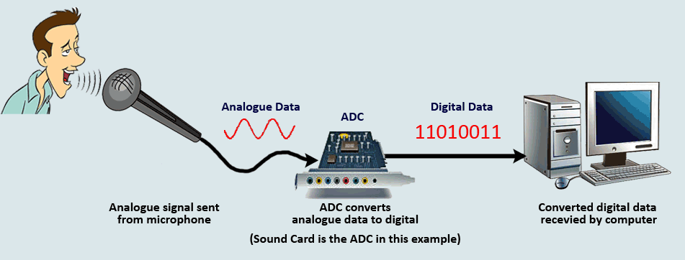

Slide 31
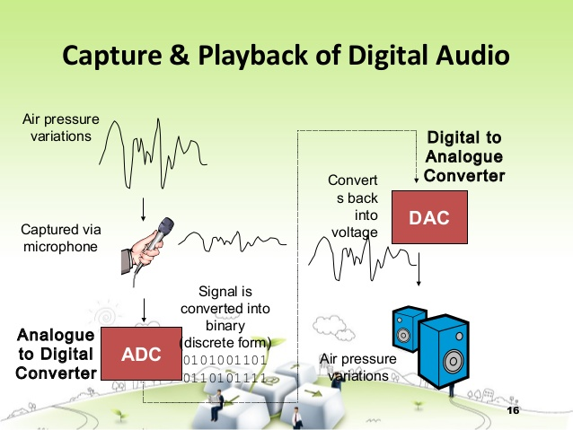

Slide 32
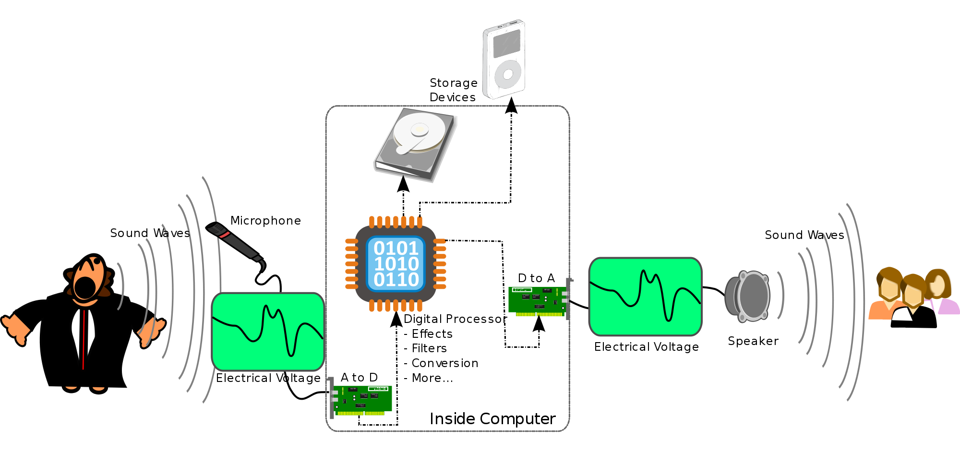

Slide 33
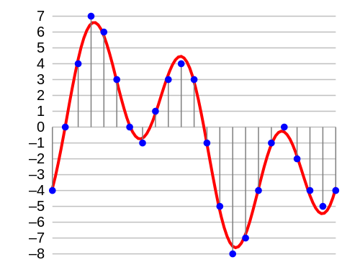
Procedure of audio digitalization
Analog Signal
Digital Signal
A/D ADC
D/A DAC
(Nature World)
(Computer)
Analog Signal
Digital Signal
Sampling
Quantization
Coding
conversion to a stream of numbers, and preferably these numbers should be integers for efficiency.
Notes:
Acoustical:听觉的，声学的A microphone converts the pressure waves of sound into voltage changes in a wire: high pressure becomes positive voltage, and low pressure becomes negative voltage.
When you record from a microphone into a computer, for example, analog-to-digital converters transform the analog signal into digital samples that computers can store and process.
Since we are interesting in working with such data in computer storage,we must digitize the analog signal produced by microphone. digitize means conversion to a stream of number.

Slide 34
Procedure of audio digitalization
Sampling means dividing continuous time into discrete time
Quantization means measuring the amplitude at fixed interval
Coding means forming a digital sequence in accordance with certain rules
Continuous Analog Waveform
Sampling
Quantization
Illustration
Coding: 10100100…1110001000
Discretized Audio

Slide 35
Understanding sample rate
Sample rate indicates the number of digital snapshots taken of an audio signal each second. This rate determines the frequency range of an audio file. The higher the sample rate, the closer the shape of the digital waveform is to that of the original analog waveform.

Slide 36
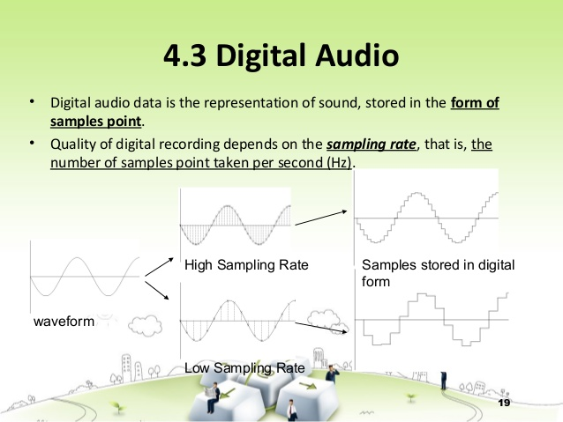

Slide 37
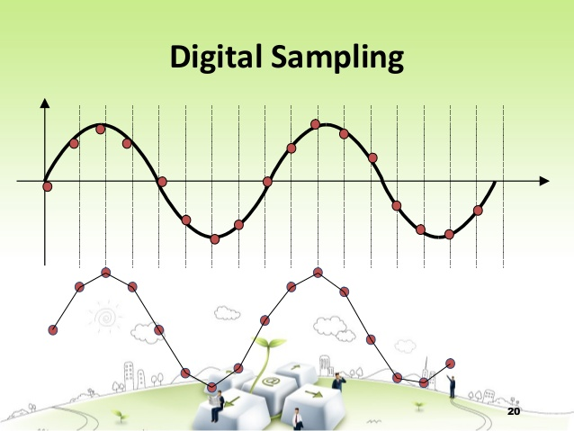

Slide 38
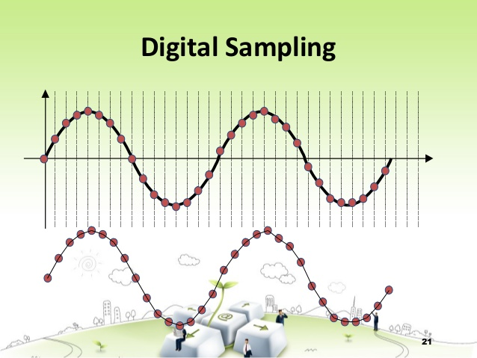

Slide 39
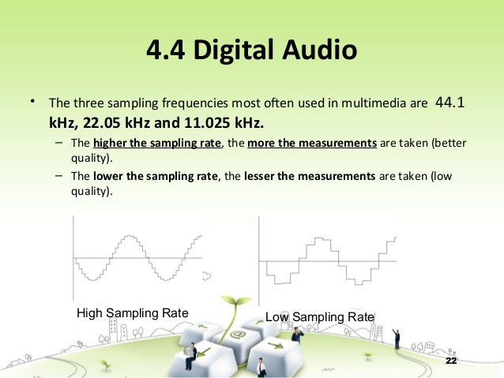

Slide 40
Understanding sample rate
To reproduce a given frequency, the sample rate must be at least twice that frequency. For example, CDs have a sample rate of 44,100 samples per second, so they can reproduce frequencies up to 22,050 Hz, which is just beyond the limit of human hearing, 20,000 Hz.

Slide 41
Understanding bit depth
When a sound wave is sampled, each sample is assigned the amplitude value closest to the original wave’s amplitude. Higher bit depth provides more possible amplitude values, producing greater dynamic range, a lower noise floor, and higher fidelity.
Notes:
Amplitude is measured in decibels below full scale, or dBFS. The maximum possible amplitude is 0 dBFS; all amplitudes below that are expressed as negative numbers.

Slide 42
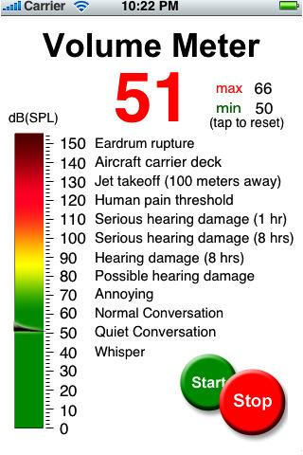
dB(Decibel)
dB is commonly used in acoustics as a unit of sound volume. 0dB is the quietest sound our ear can hear, 120dB will cause permanent damage to our ear.
Notes:
Amplitude is measured in decibels below full scale, or dBFS. The maximum possible amplitude is 0 dBFS; all amplitudes below that are expressed as negative numbers.
The human ear has a large dynamic range in sound reception. The ratio of the sound intensity that causes permanent damage during short exposure to that of the quietest sound that the ear can hear is greater than or equal to 1 trillion (1012).[34] Such large measurement ranges are conveniently expressed in logarithmic scale: the base-10 logarithm of 1012 is 12, which is expressed as a sound pressure level of 120 dB re 20 μPa.

Slide 43
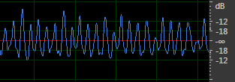
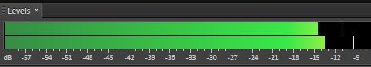
dBFS(dB relative to full scale)
dBFS(dB relative to full scale) is a unit of measurement for amplitude levels in digital systems. The level of 0 dBFS is assigned to the maximum possible digital level.
Notes:
Amplitude is measured in decibels below full scale, or dBFS. The maximum possible amplitude is 0 dBFS; all amplitudes below that are expressed as negative numbers.
The human ear has a large dynamic range in sound reception. The ratio of the sound intensity that causes permanent damage during short exposure to that of the quietest sound that the ear can hear is greater than or equal to 1 trillion (1012).[34] Such large measurement ranges are conveniently expressed in logarithmic scale: the base-10 logarithm of 1012 is 12, which is expressed as a sound pressure level of 120 dB re 20 μPa.

Slide 44
Affects of Data Size
Data Size =Sample Rate×Bit Size×#Channel/8(Byte/s)
Sample Rate (kHz) | Bit Size (bit) | Data Size(KB/s)
 |  | Mono | Stereo
11.025 | 8 | 10.77 | 21.53
 | 16 | 21.53 | 43.07
22.05 | 8 | 21.53 | 43.07
 | 16 | 43.07 | 86.13
44.1 | 8 | 43.07 | 86.13
 | 16 | 86.13 | 172.27

Slide 45
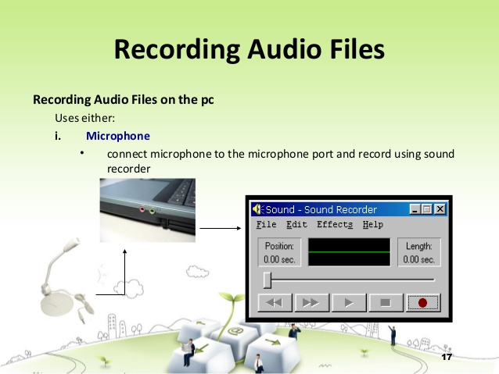

Slide 46
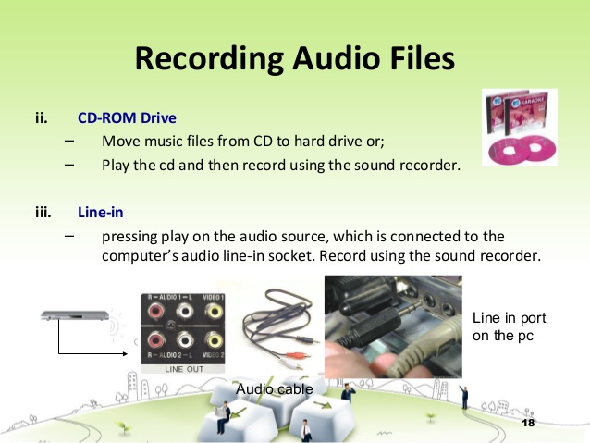

Slide 47
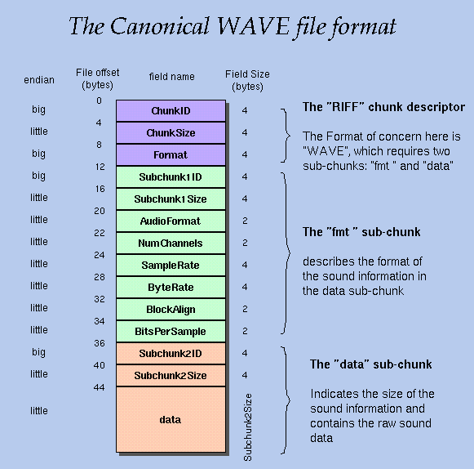
2.3 Audio File Format
An audio file format is a file format for storing digital audio data on a computer system.
An audio file usually contains a header indicating sample rate, bit depth etc(metadata), and then a large number of digital audio data.
Notes:
Audio data is stored in a file on a computer
An audio file format is a file format for storing digital audio data on a computer system.
Although most audio file formats support only one type of audio coding data (created with an audio coder), a multimedia container format (as Matroska or AVI) may support multiple types of audio and video data.

Slide 48
Format types
The bit layout of the audio data (excluding metadata) is called the audio coding format and can be uncompressed.
It is important to distinguish between audio file(container) format and audio coding format.
A coding format and a file format are usually defined in one compression standard, so most audio file formats support only one type of audio
Audio File
(Audio File Format)
Audio Data
(Audio Coding Format)
Notes:
2017-10-18
a multimedia container format (as AVI) may support multiple types of audio and video data.

Slide 49
2.4 Digital Audio Acquisition and Processing
Audio Acquisition
i) Sound Recorder Software(eg. Sound Recorder in Win 7)
ii) Recording Studio
iii) Audio CD, Audio Tape(eg. Window Media Player>Ripping)
iv) Digital Audio Library
Audio Processing
i) Audio Edition, Mixing
ii) Noise Reduction
iii) Modulation, Delay, Echo Effects

Slide 50
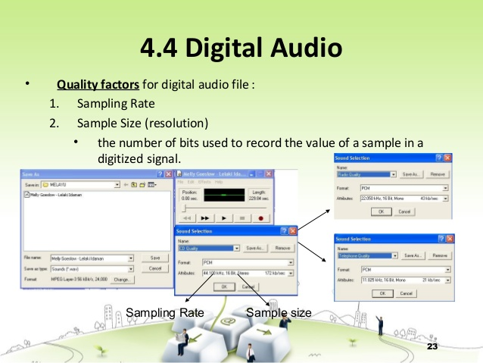

Slide 51
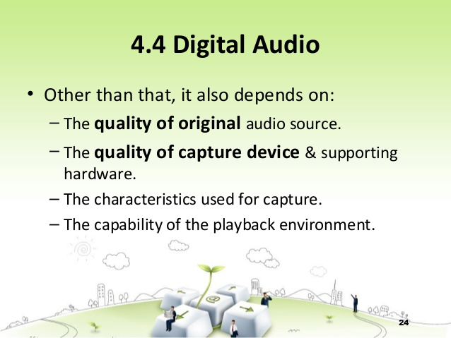

Slide 52
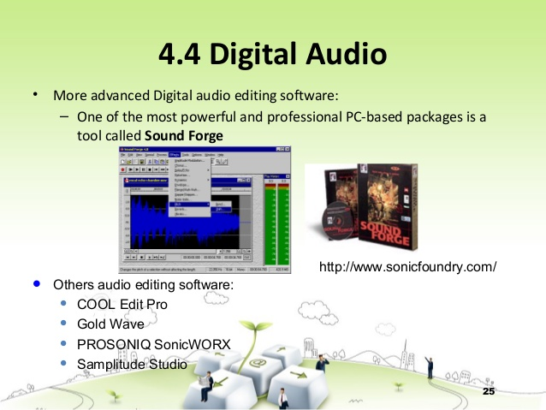

Slide 53
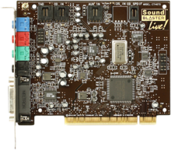
2.6 Sound Card and Electroacoustic Equipment
Sound Card
An internal expansion card that facilitates input and output of audio signals to and from a computer under control of computer programs..
Notes:
Sound cards for computers compatible with the IBM PC were very uncommon until 1988, which left the single internal PC speaker as the only way early PC software could produce sound and music.[3] The speaker hardware was typically limited to square waves, which fit the common nickname of "beeper". The resulting sound was generally described as "beeps and boops". Several companies, most notably Access Software, developed techniques for digital sound reproduction over the PC speaker (see RealSound); the resulting audio, while barely functional, suffered from distorted output and low volume, and usually required all other processing to be stopped while sounds were played.
Adlib: First mass market PC soundcard for computers, 1992 - Ad Lib filed for bankruptcy
Creative Sound Blaster 1.0 released within the following year assisted by full compatibility with the then market leader Ad Lib, Inc.'s sound card, allowed the firm to achieve competitive control of the PC audio market by 1992.[24] Ad Lib, Inc. went bankrupt in 1992.
With more features at nearly the same price, and compatibility as well, most buyers chose the Sound Blaster. It eventually outsold the AdLib and dominated the market.

Slide 54
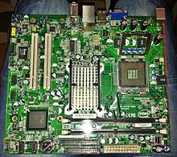
Integrated sound hardware on PC motherboards
In the late 1990s many computer manufacturers began to replace plug-in soundcards with a "codec" chip integrated into the motherboard.
The integrated sound system is often still referred to as a "sound card".
The best plug-in cards, which use better and more expensive components, can achieve higher quality than integrated sound.
Notes:
Sound functionality can also be integrated onto the motherboard, using components similar to plug-in cards. The best plug-in cards, which use better and more expensive components, can achieve higher quality than integrated sound. The integrated sound system is often still referred to as a "sound card".
A codec is a device or computer program for encoding or decoding a digital data stream or signal. Codec is a portmanteau of coder-decoder

Slide 55

Architecture of Sound Card
Mixer receives inputs from both external connectors and D/A. It selects or mutes, amplifies these signals, adds them together, and finally routes the result to both external output connectors and A/D. (see Mixer in Win7)
Microphone in
Loudspeaker out
Mixer
Line in
Line out
A/D & D/A
Audio Processor
Music Synthesizer
MIDI
CD Interface
Card bus Interface
Computer Bus
Notes:
Practically all normal PC soundcards have a built-in computercontrollable mixer functionality which is used to adjust howloudly different sound sources sound out and also controls whatis being recorded by the soundcard.
Mixer receives inputs from both external connectors and the sound card's digital-to-analog converters. It selects or mutes, amplifies (with variable gain) these signals, adds them together, and finally routes the result to both external output connectors and the sound card's analog-to-digital converters. Synthesizers may either imitate other instruments or generate new timbres.
To use a sound card, the operating system (OS) typically requires a specific device driver, a low-level program that handles the data connections between the physical hardware and the operating system. Some operating systems include the drivers for many cards; for cards not so supported, drivers are supplied with the card, or available for download.

Slide 56
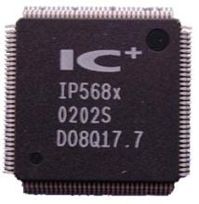
Audio Codec
A single chip in soundcard
encodes analog audio as digital signals and decodes digital back into analog.
compress and decompress digital audio data according to a given audio coding format. (may used by audio processing software and multimedia players)
Notes:
In other words, it contains both an analog-to-digital converter (ADC) and digital-to-analog converter (DAC)

Slide 57
Device Driver
A low-level program that controls a device attached to a computer.
Provides a software interface to hardware devices, enable operating systems to access hardware functions without needing to know details of the hardware being used.
Multimedia Applications
The main purpose of Device drivers is to provide abstraction by acting as translator between a hardware device and the operating systems that use it
Multimedia Develop Tools
Multimedia Operating System
Multimedia Drivers
Multimedia Hardware System
Notes:
To use a sound card, the operating system (OS) typically requires a specific device driver, a low-level program that handles the data connections between the physical hardware and the operating system. Some operating systems include the drivers for many cards; for cards not so supported, drivers are supplied with the card, or available for download.
A driver provides a software interface to hardware devices, enabling operating systems and other computer programs to access hardware functions without needing to know precise details of the hardware being used.
The main purpose of Device drivers is to provide abstraction by acting as translator between a hardware device and the applications or operating systems that use it.[1] Programmers can write the higher-level application code independently of whatever specific hardware the end-user is using.

Slide 58

General Characteristics
i) Recording, editing, and playback of digital audio file.
ii) Controlling and mixing sounds from different sources.
iii) Compression and decompression in recording and playback.
iv) Music Synthesis．
v) Support MIDI interface．
It can be used in multimedia applications such as music composition, audio editing, presentation, education, entertainment (games) , etc
Notes:
Synthesis:合成
The main function of a sound card is to play audio, usually music, with varying formats (monophonic, stereophonic, various multiple speaker setups) and degrees of control. The source may be a CD or DVD, a file, streamed audio, or any external source connected to a sound card input.
Audio may be recorded. Sometimes sound card hardware and drivers do not support recording a source that is being played.

Slide 59
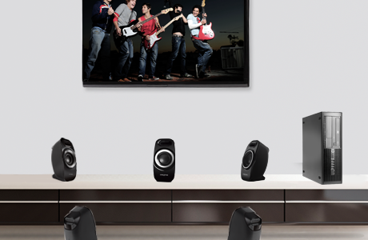
Example
Enjoy multi-channel cinematic sound
Many sound cards come with 5.1 channel outputs so you can connect to your existing multi-channel speakers with ease.

Slide 60
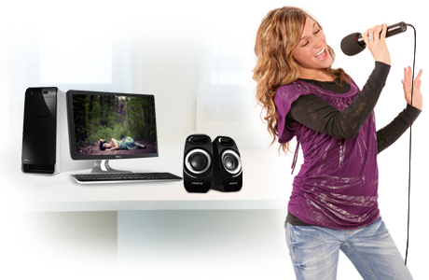
Example
Independent input sources
Many sound cards come with independent line-in and microphone connectors, which allow you to plug in two different audio sources to your PC.
You can plug in your MP3 player and sing along, while recording your singing session for your friends to enjoy!

Slide 61
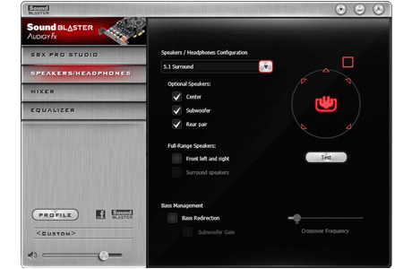
Example
Control and customize your audio
Many sound cards come with audio processing software, which is designed to bring cinematic difference to home theatre PCs! You can also adjust the level of immersion you like, simply by adjusting the sliders on Control Panel.

Slide 62
Quality Parameters
Audio Performance
Sample Rate：
11.025 kHz (Speech) 22.05 kHz (Music) 44.1 kHz (Hi-Fi)
Bit Size：
8 bits/256 (Speech) 16 bits/65 536 (Hi-Fi)
SNR(Signal-to-noise ratio)：>80db
Notes:
For all measurement purposes a sound card must be chosen with good audio properties. It must itself contribute as little distortion and noise as possible, and attention must be paid to bandwidth and sampling.
信噪比是音箱回放的正常声音信号与无信号时噪声信号(功率)的比值。用dB表示。例如，某音箱的信噪比为80dB，即输出信号功率比噪音功率大80dB。信噪比数值越高，噪音越小。

Slide 63


Slide 64


Slide 65


Slide 66


Slide 67


Slide 68


Slide 69


Slide 70


Slide 71


Slide 72


Slide 73


Slide 74


Slide 75


Slide 76


Slide 77


Slide 78


Slide 79


Slide 80


Slide 81


Slide 82


Slide 83


Slide 84


Slide 85

Adobe Audition
Audio Processing Software
(formerly Cool Edit Pro)
Audio Editing
Audio Effects
Multitrack Processing
Burning Audio CD

Slide 86

History
1990s, Syntrillium Software, Cool Edit,
2003, Adobe purchased Cool Edit Pro, Adobe Audition 1
2006, 2007 Adobe Audition 2, 3
2011, 2012 Adobe Audition 4, 5(CS5.5, CS6 as part of Adobe Creative Suite)
2013, 2014, 2015 Adobe Audition 6, 7, 8(CC, CC2014, CC2015)
Notes:
Adobe purchased Cool Edit Pro from Syntrillium Software in May 2003 for $16.5 million
Audition 4, also known as Audition CS5.5, was released on April 11, 2011 as part of Adobe Creative Suite.

Slide 87
Workspace
A View buttons and toolbar B Editor panel with zoom navigator at top C Various other panels D Status bar
Notes:
Adobe Audition provides different views for editing audio files and creating multitrack mixes.

Slide 88


Workspace
Waveform and Multitrack Editors
To edit individual files, use the Waveform Editor. To mix multiple files and integrate them with video, use the Multitrack Editor.
The Waveform and Multitrack editors use different editing methods, and each has unique advantages.
Notes:
Adobe Audition provides different views for editing audio files and creating multitrack mixes.

Slide 89

Workspace
Waveform Editor Panel
A
F
B
C
Waveform Editor Panel
D
F
G
E
A Navigator B Timeline Ruler C Waveform Display D Spectral Display
E Zoom Button F Current-Time Indicator/Display G Play Buttons
Notes:
High pitch, low pitch

Slide 90

Workspace
Spectral Display
This view lets you analyze audio data to see which frequencies are most prevalent. Brighter colors represent greater amplitude components. Colors range from dark blue (low-amplitude frequencies) to bright yellow (high-amplitude frequencies).
The spectral display is perfect for removing unwanted sounds, such as coughs and other artifacts.
Notes:
High pitch, low pitch

Slide 91
Workspace
Zoom audio
Zoom into a specific time range
In either the zoom navigator or the timeline ruler, right-click and drag
Extend or shorten the displayed range
Drag the left or right edge of the highlighted area in the zoom navigator
Using zoom button in the Editor panel
Notes:
Adobe Audition provides different views for editing audio files and creating multitrack mixes.

Slide 92


Workspace
Navigating time and playing audio
Navigate by scrolling
Navigate with the Selection/View panel
Current-time indicator(CTI) lets you start playback or recording at a specific point
Notes:
Adobe Audition provides different views for editing audio files and creating multitrack mixes.

Slide 93

Importing, recording, and playing
Recording audio
You can record audio from a microphone or any device you can plug into the Line In port of a sound card.
Set audio inputs
Create or open a file
Click the Record button to start and stop recording
NB. When recording in noisy environments, record a few seconds of representative background noise that can be used as a noise print later on.
Notes:
Adobe Audition provides different views for editing audio files and creating multitrack mixes.

Slide 94
Importing, recording, and playing
Monitoring recording and playback levels
To monitor the amplitude of incoming and outgoing signals during recording and playback, we use level meters.
If amplitude is too low, sound quality is reduced; if amplitude is too high, clipping occurs and produces distortion.
Notes:
Adobe Audition provides different views for editing audio files and creating multitrack mixes.

Slide 95
Editing Audio
Selecting audio for playing, copying, cutting, (mix)pasting, and deleting
Select time ranges using Time Selection tool
Select spectral ranges using free-form selection tools
A Marquee
B Lasso
C Paintbrush
Notes:
To extend or shorten a selection, drag the selection edges.
The Marquee Selection tool lets you select a rectangular area. The Lasso Selection and Paintbrush Selection tools let you make free-form selections.
All three tools allow for detailed editing and processing, including incredible flexibility in audio restoration work. For example, if you find audio artifacts, you can select and edit just the affected frequencies, producing superior results with faster processing.

Slide 96
Editing Audio
Remove artifacts automatically
For the quickest repair of small, individual audio artifacts like isolated clicks or pops, use the Spot Healing Brush .
Example: coughinmusic.wav
A Before
B After
Notes:
To extend or shorten a selection, drag the selection edges.
The Marquee Selection tool lets you select a rectangular area. The Lasso Selection and Paintbrush Selection tools let you make free-form selections.
All three tools allow for detailed editing and processing, including incredible flexibility in audio restoration work. For example, if you find audio artifacts, you can select and edit just the affected frequencies, producing superior results with faster processing.

Slide 97

Editing Audio
Adjust amplitude using amplitude control
By default, the visual amplitude control appears in a heads-up display (HUD) that floats over all waveforms
Example: tooquite.wav
Notes:
To extend or shorten a selection, drag the selection edges.
The Marquee Selection tool lets you select a rectangular area. The Lasso Selection and Paintbrush Selection tools let you make free-form selections.
All three tools allow for detailed editing and processing, including incredible flexibility in audio restoration work. For example, if you find audio artifacts, you can select and edit just the affected frequencies, producing superior results with faster processing.

Slide 98
Multitrack routing
Buses, sends, and the Master track let you route multiple track outputs to one set of controls. With these combined controls, you can efficiently organize and mix a session.
Notes:
Sends let you route audio from a track to multiple buses, creating tremendous signal-routing flexibility. Each track provides up to 16 sends, which you configure independently from the track output. For example, you can output an unprocessed track directly to a hardware port, but output Send 1 to a reverb bus and Send 2 to a headphone bus. (A headphone bus lets performers hear a unique mix during recording. Drummers, for example, may prefer a louder bass track.)
A Send

Slide 99
Summary
☆Audio Digitalization, Music Symbolization
☆Three Essentials of Digital Audio, Audio File Formats
☆Sound Card and Electroacoustic Equipment
☆Electric Music and MIDI
☆Audio Processing Software: Audition

